Slide 1
DNET Server Redesign
Speaker : Richard Wang

Slide 2
Apply MVC Model
View
html/css
display
update
manipulate
User
Controller
javascript
model
php
use
response

Slide 3
MVC flow - login
View
html/css
6.display after login page
5.update view to after login page
2.login request
User
Controller
javascript
3.pass/error msg
model
php
1.press login
botton
4.if pass get html

Slide 4
Apply MVC Model
parallel development
view
controller
modal

Slide 5
Advantage of MVC
View
android app layout
6.display after login page
5.update view to after login page
2.login request
User
Controller
android app
java code
3.pass/error msg
model
php
1.press login
botton
4.if pass get html

Slide 6
Features
Register
user register
username / e-mail input
send password to user email
orgnization register
username/email/orgname/address input
send password to org email

Slide 7
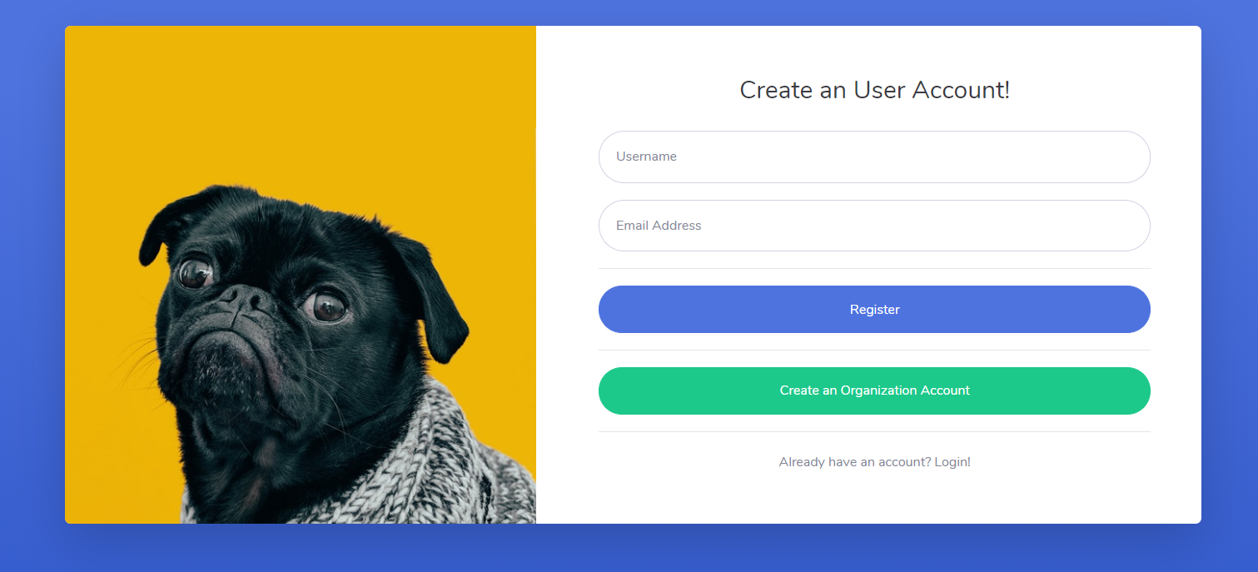
Features
Register

Slide 8
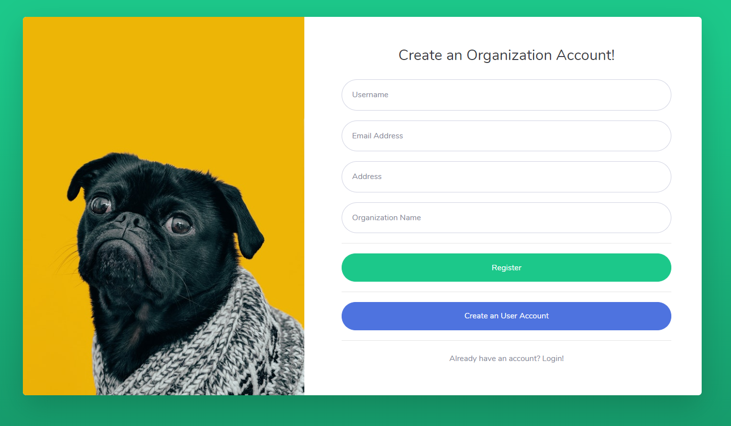
Features
Register

Slide 9
Features
Login
user login
org login
admin login

Slide 10
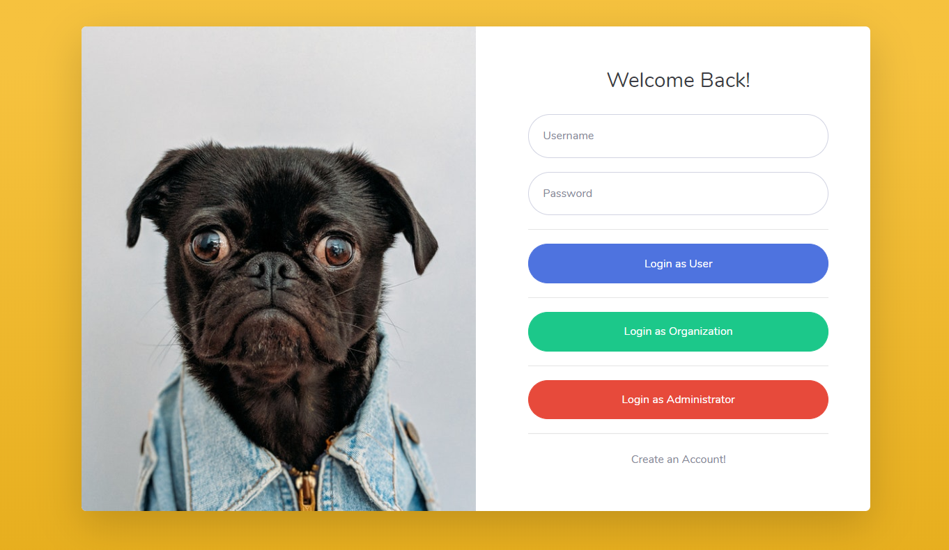
Features
Login

Slide 11
Features
User
choose org to join
fill in attribute form
choose org have joined
show user attribute of the org
download key and parameter file
modify user attribute of the org

Slide 12
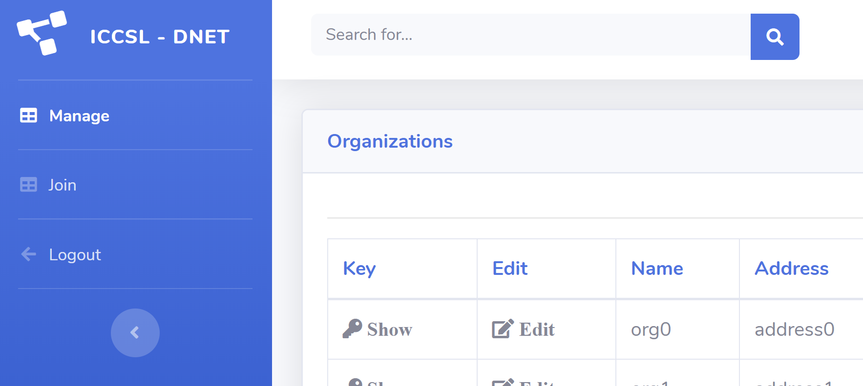
Features
User

Slide 13
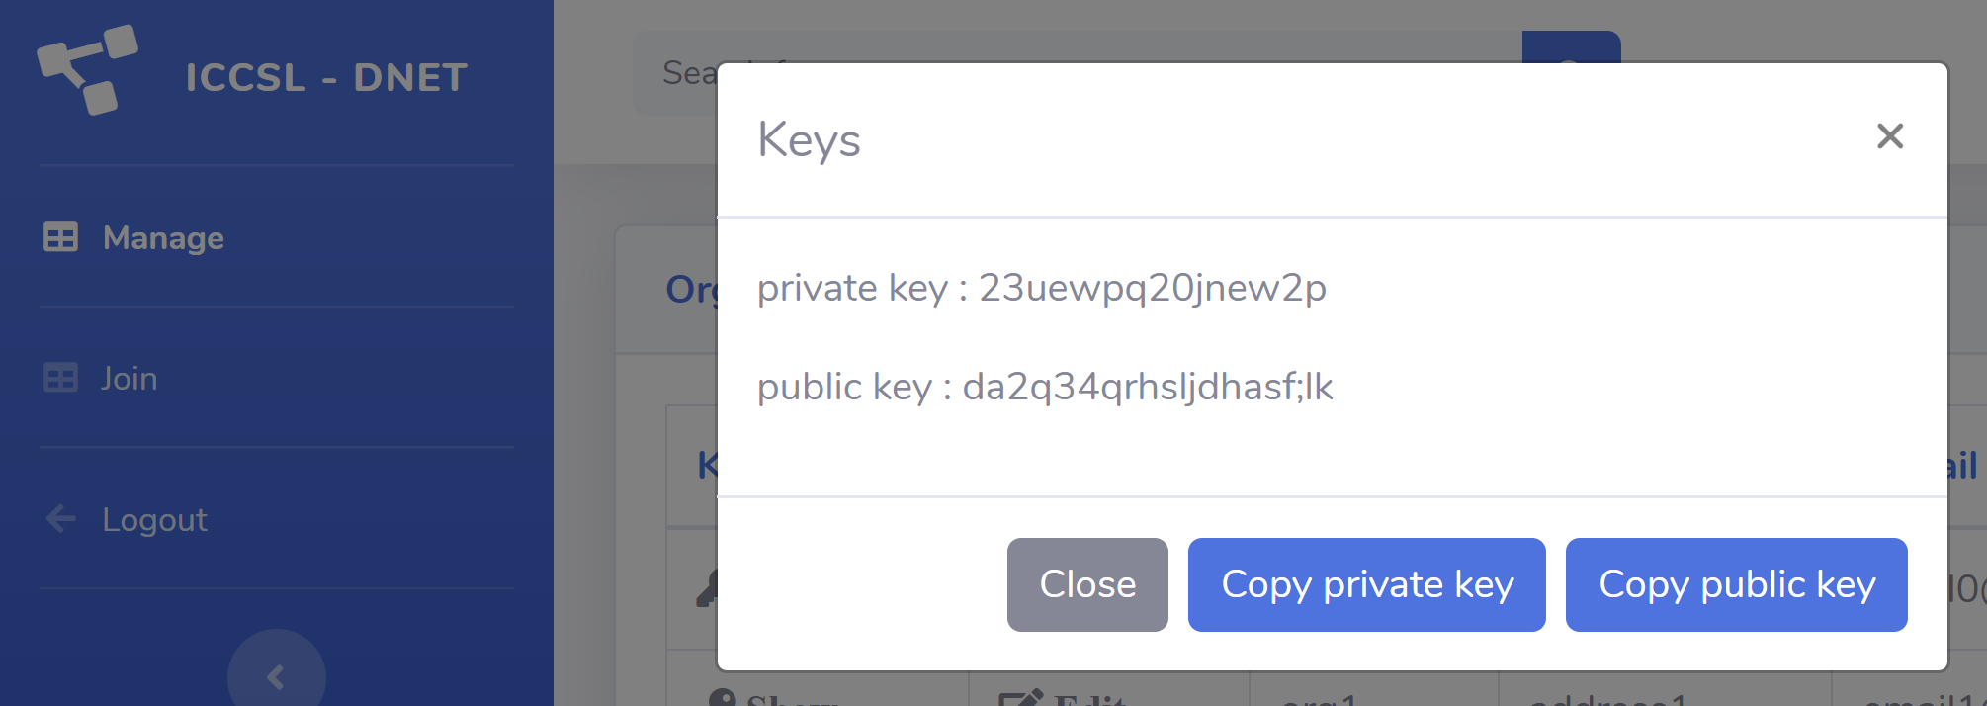
Features
User

Slide 14
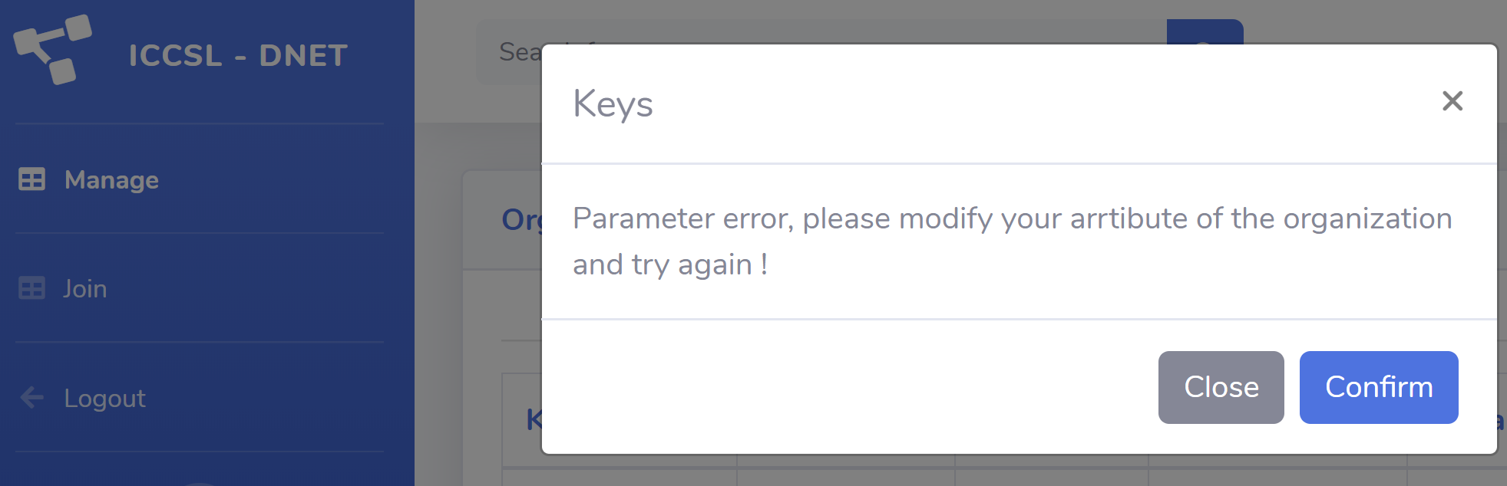
Features
User

Slide 15
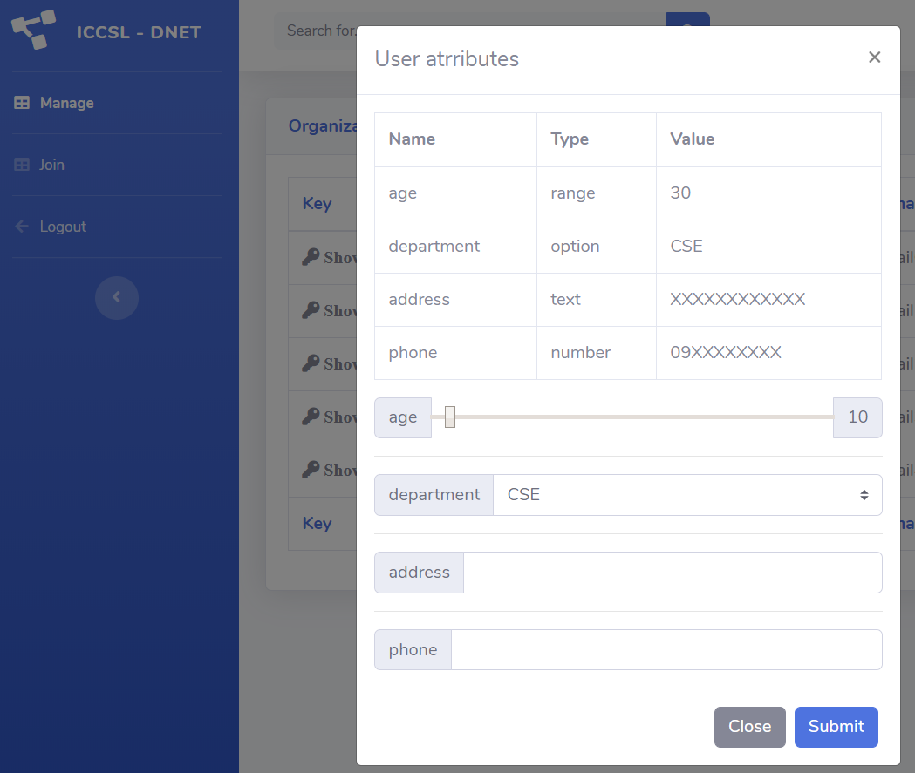
Features
User

Slide 16
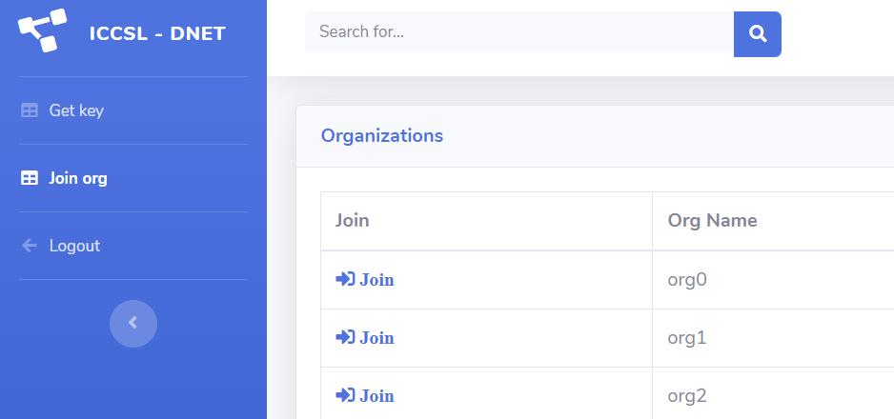
Features
User

Slide 17
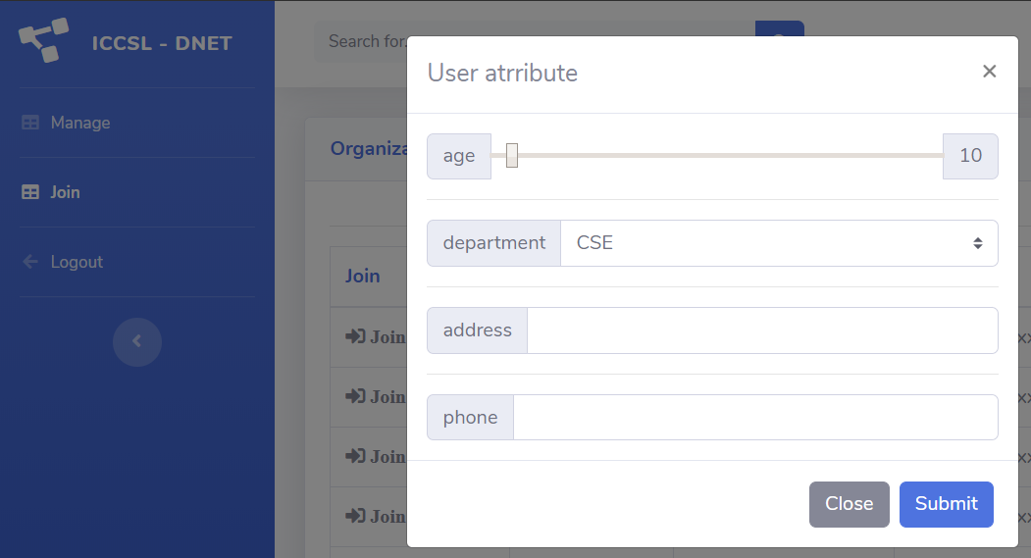
Features
User

Slide 18
Features
Org
show self and edit attribute
show this org user list
show user attribute
modify user attribute
remove user

Slide 19
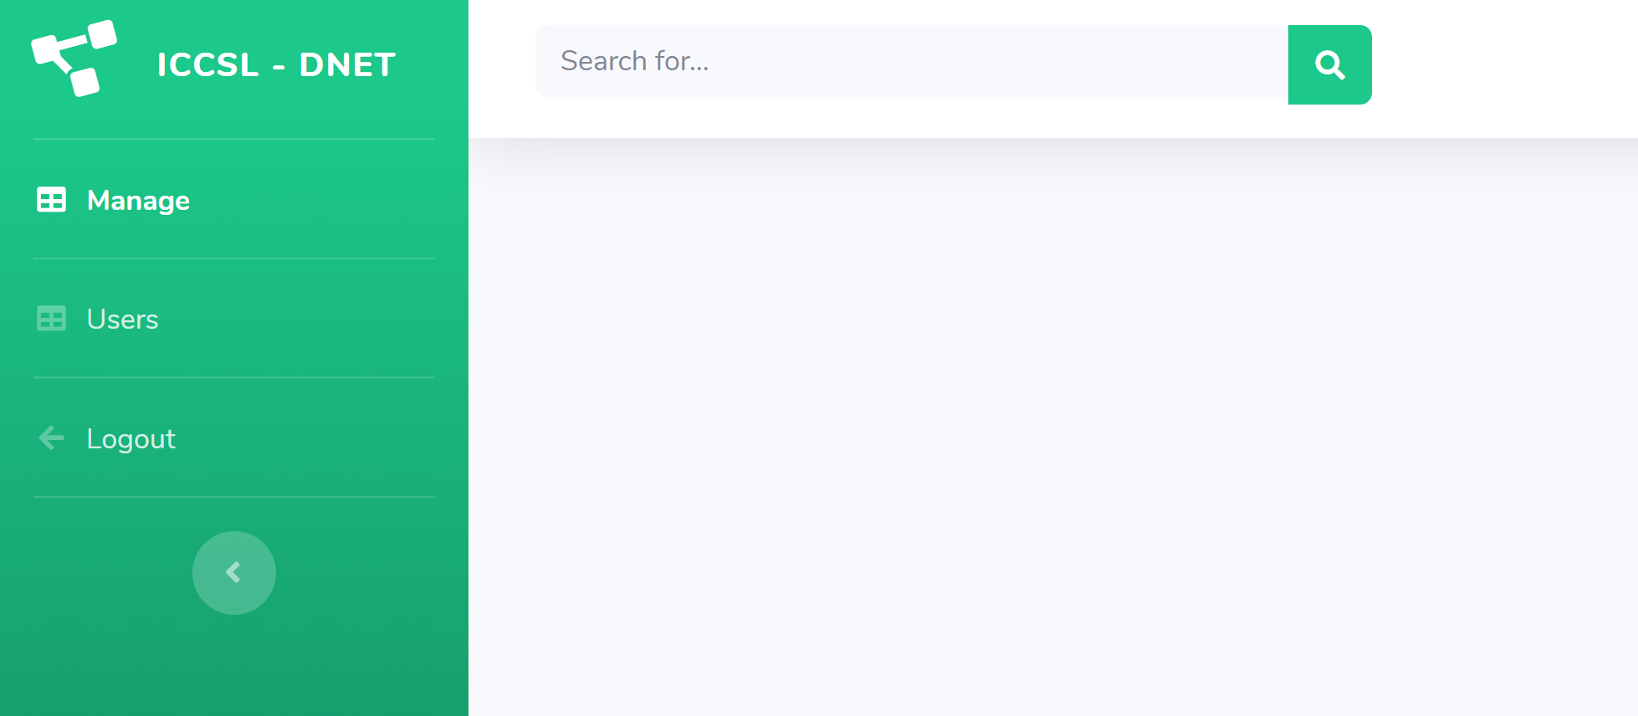
Features
Org

Slide 20
Features
Admin
show all user list
show user attribute
modify user attribute
remove user attribute
show all org list
show org attribute
modify org attribute
remove org attribute

Slide 21
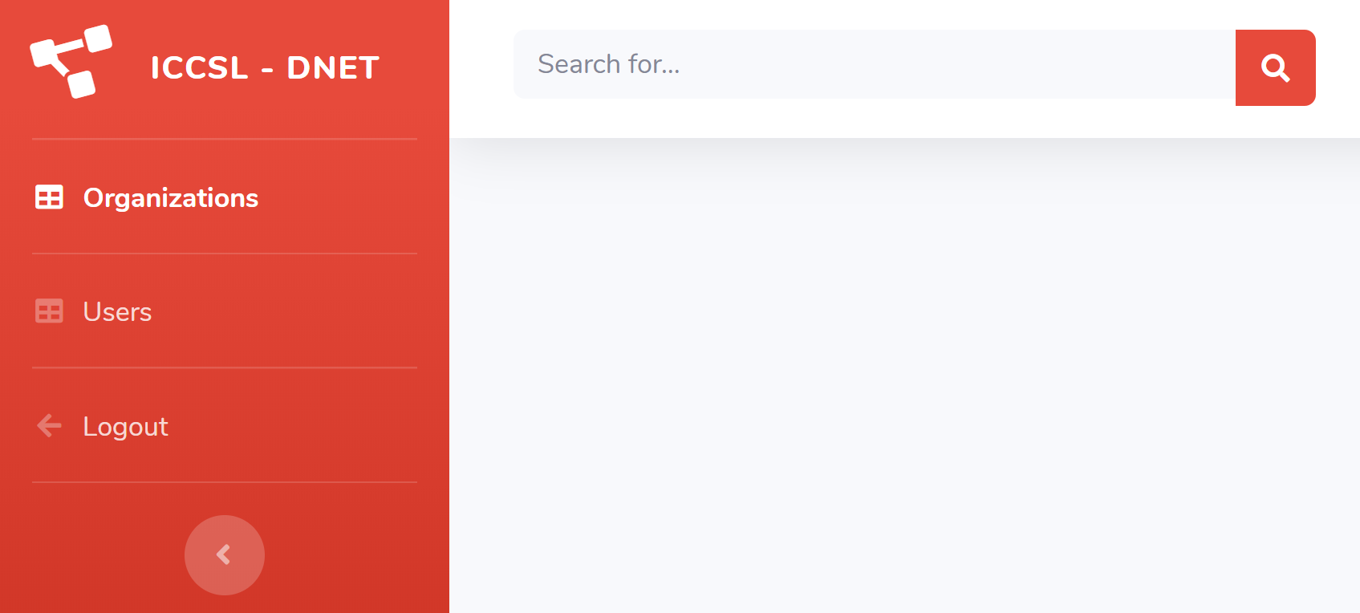
Features
Admin

Slide 22
System structure
register
login
user
org
admin
manage
show join org list,
show and edit its attributes
join
show not
join orgs,
send join request
manage
show and add and edit attr
of itself
users
show user of the org and edit user attr
orgs
show all orgs and edit each org’s attr and info
users
show all users and edit each user’s attr and info

Slide 23
THANK YOU
ANY QUESTIONS?

